Slide 1
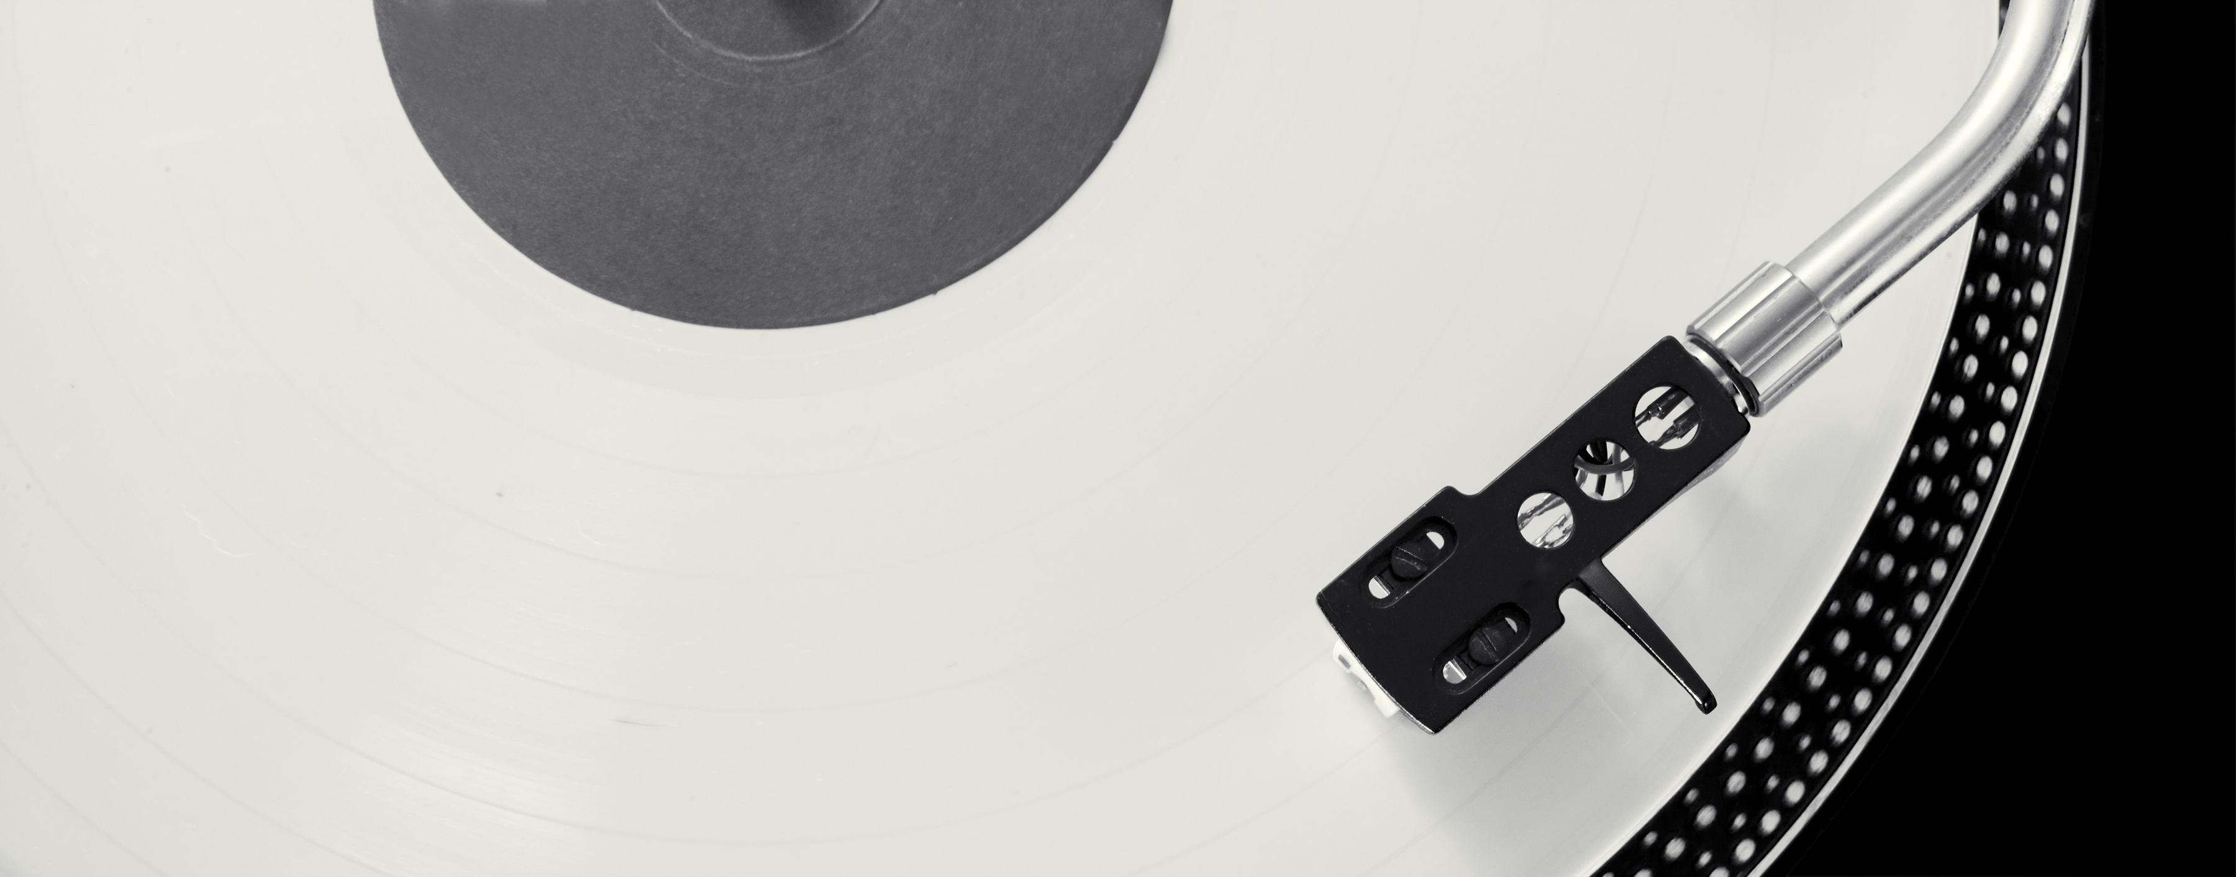

Music
Chiptune

Slide 2
Meet Our Team
Ahmad Azeez
Meenakshi Rajesh

Slide 3

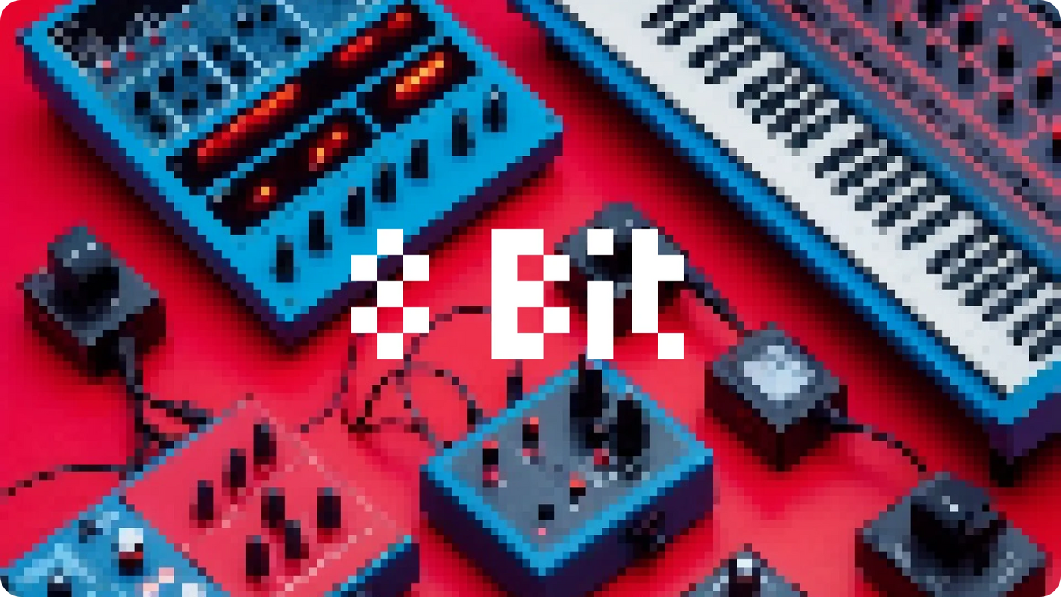
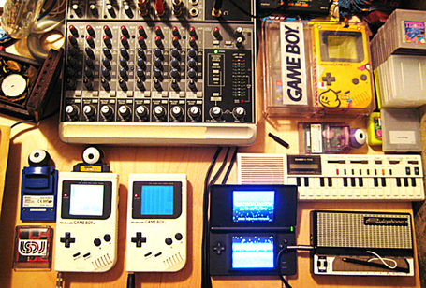

ART - CHIPTUNES
(8 BIT AUDIO)

Slide 4
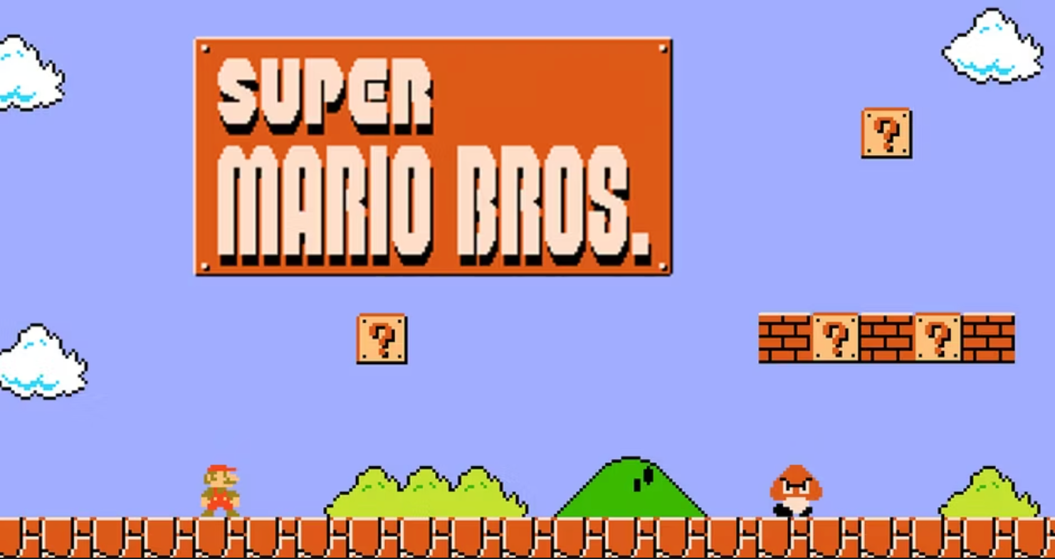
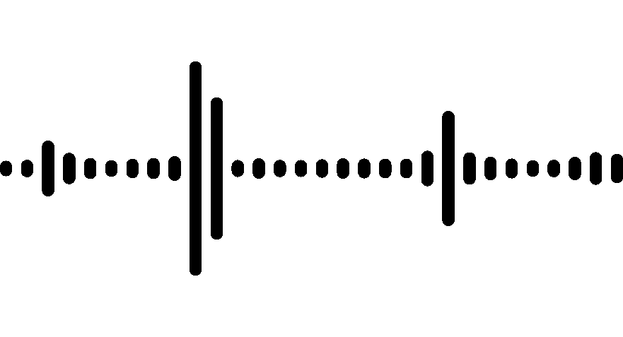

RETRO VIDEO MUSIC

Slide 5
Method
We used a genetic algorithm model
Chromosome was based on a list of MIDI note and time duration pairs and on an evaluation to the array of the target melody.
Uses tournament selection to select parent chromosomes, which then exchange note-duration pairs to produce offspring.
Introduces variability by randomly changing notes or durations, improving the population steadily until a high-fitness solution is reached.

Slide 6
Fitness Evaluation
Compares the generated MIDI notes to the original input notes to evaluate accuracy.
Assesses how closely the generated note durations match the input's rhythm.
Ensures the use of square waveforms and limits complexity to preserve 8-bit characteristics.
Assigns a score out of a specific maximum (depends on the target melody length) based on the alignment of melody and rhythm, with the maximum representing a perfect match.

Slide 7
Showcase
Mission Impossible (Original)
Mortal Kombat (Original)
Mission Impossible (GA’s Chiptune Version)
Mortal Kombat (GA’s Chiptune Version)
Pink Panther Theme (Original)
Pink Panther Theme (GA’s Chiptune Version)

Slide 8
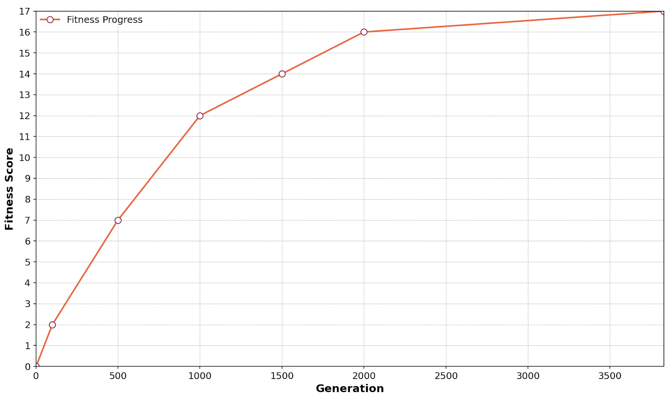
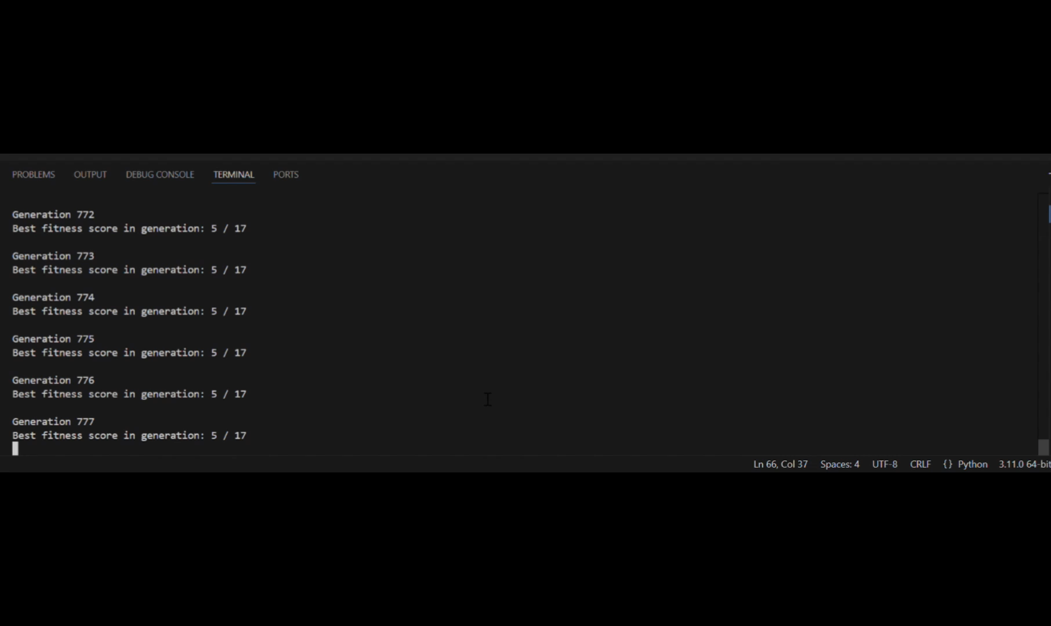
Fitness Score Progression Over Generations

Slide 9
Next Steps
Full Track Conversion: Expand from small segments to directly converting entire audio tracks into MIDI format, enabling the processing of full songs.
Upgraded Chromosome Structure: Transition to a 2D array representation to efficiently handle detailed note information (pitch, duration, amplitude), improving output audio.
Instrument Separation: Separate musical elements (melody, percussion, bassline) and apply genetic algorithms to each independently, enhancing the richness and complexity of the audio output.

Slide 10
Thank You - Questions ?

